Slide 1
CROOKSTON ON THE MOVE: CONNECTING THE COMMUNITY THROUGH TRAILS
Project by: MKTG 4800 & NATR 3344
Supervised by Dr. Al Fattal and Dr. Eric Castle
Notes:
Alex
Intro was very good

Slide 2
TABLE OF CONTENTS
I. Background/Roles/Objective
II. Current State of the Trails
III. Project Design
IV. Pestel Analysis
V. Methodology
VI. Survey Results
VII. SWOT Analysis
VIII. Objective
IX. Consumer Analysis
X. The 4 P’s of Marketing/Masterplan
Notes:
Clara
presentation notes: a litle too much, simply mention 4p's and no conclusion.
items 11: /masterplan from natr class
remove story
completed

Slide 3
STORY
Story:
Al and Eric
Important for us as learners
Gave a change to work on a long term research project
Important for the community
Trails can have many impacts on the community
Notes:
Al + Eric will present the story and Mckenna will give the importance

Slide 4
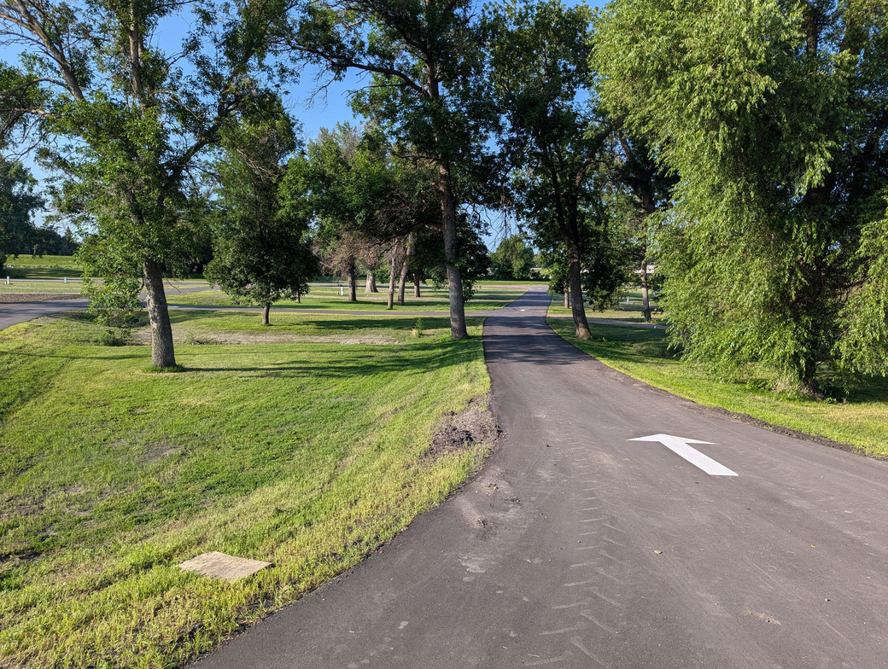
BACKGROUND/ROLE/OBJECTIVE
Roles of the classes
Background: To utilize Nature-specific marketing strategies and field specific notes to find the objective
Objective:
1. Increase pedestrian use of trails by 10%.
2. Identify location and condition of current trail networks.
3. Recommend specific enhancements and trail network expansions.
Notes:
Tristan
Role: What each of the classes had done, the work of each class

Slide 5
CURRENT STATE OF TRAILS/BACKGROUND
Existing Networks are unconnected in many areas
Kreutzberg, Aunt Poly’s Pond, Bob's Pond, Red River Natural History Area, and Castle Park are nature-oriented
Oakdale Cemetery is the middle ground between nature and mobility-friendly
Veterans Military Memorial Loop and Fisher Trail are popular foot and bike trails
Scan for map of existing trails
Notes:
good explanation of how the trails could be connected and who are using them
David will prepare a min explanation on this slide

Slide 6
PROJECT DESIGN
SECONDARY
RESEARCH
NEEDS
ASSESSMENT
SURVEY
RECCOMMENDATION
FIELD ANALYSIS
Notes:
Braden
Al + Eric planned a project, secondary research (get ideas), survey with collecting data, field notes from trails by NTAR class, which all led to recomendations

Slide 7
WHAT IS PESTEL?
Political
Economical
Social
Technological
Environmental
Legal
Notes:
Alex
Market audit = to understand the market
Politcal, economic, social, technological, environment, legal

Slide 8
PESTEL PT.1
ECONOMIC
SOCIAL
TECHNOLOGICAL
85.6% commute by car
74.8% have <20 min travel times
Trails can boost tourism, small business revenue, and economic growth
Trails with attractions = higher economic impact
Trails foster social communities, safety, public health
Benefit youth and seniors through transport options and physical activity
Age groups: 10-15 and 55-60 benefit most
Lack of trail promotion is current barrier
GIS and drones improve trail planning and maintenance
Apps: AllTrails, Strava & Carin enhance navigation, safety, community
IoT devices track trail usage and inform data-driven decisions
Virtual tools and social media help market trails
Notes:
Alex
Study the Concept:
link the points to the trails (why are we telling them this)
why the median income is included (is there a link to it, if not, take it out)

Slide 9
PESTEL PT.2
POLITICAL
ENVIRONMENTAL
LEGAL
A proposed trail system would have to be approved by multiple parties depending on the location of the trail
Established trails in Crookston start with the city engineer along with the Parks and Recreation department, then it will get voted on by the Park Board/Council
Trails by the dyke would need approval from the Army Corp of Engineers and the MN DNR
Weather and climate are significant components of their maintenance and use when it comes to the trails of Crookston.
Crookston is subject to drastic climatic extremes during the summer and winter months and is located in a flat area that is exposed to wind and sun. The cycles of freezing, thawing, and the use of various heavy machinery. will accelerate these trails' degradation and maintenance schedule.
It is illegal to operate motorized vehicles and bicycles on public sidewalks, pedestrian walkways, and bicycle trails.
Snowmobiles are allowed where signs are posted.
Animals must be kept on leashes and cleaned up after.
Notes:
Eli-Political
Ethan-Environmental
Jocelyn-Legal
-political: good addition, the last bullet opoint (the word consulting should be replaced with approval) changed
- look at laws about biking on sidewalks, since it is something that is very utilized in crookston per surveys

Slide 10
SURVEY DESCRIPTION
& METHODOLOGY
Multi-channel administration within Crookston community
On U of M Crookston campus, Hugo’s, Walmart, through email
To gather public input on their knowledge & opinion of the trails
21 question survey
“How safe do you feel the trails are?”
“If you could add a new trail, where would you add it?”
“How did you become aware of the trails?”
107 responses
Notes:
Clara
thank kenan in distributing the link to the survey

Slide 11
RESULTS
Notes:
Mckenna:
Talk about more trends
Demographics:
Gender: 63% female, 32% male; remaining 5% prefer not to say or other.
Age: Largest groups—18-29 (25%) and 40-49 (24%); smallest—<18 (2.78%) and 70+ (<5%).
Trail Familiarity: 42% agreed they know the trails well; 34% disagreed; 23% neutral.
Trail Safety: Most ratings fell between 6.4-10, showing perceptions of good safety.
Trail Maintenance: 37.96% agree trails are well-kept; lowest disagreement (1.85%).
Ease of Navigation: 32.41% agree trails are easy to find; minimal strongly agree/disagree.
Safety Concerns: Key issues include poor lighting, crime, traffic, and busy roads. Word cloud visualizes responses.
Notes from Al+Eric
- no need to talk about all the details, the graphs speak for themselves.
- if it doesn't speak directly to the trails, no need to talk about it.
- talk about the trands of the survey results
-

Slide 12
RESULTS
Notes:
Tristan
Visual results
Lighting: 34% were neutral to this issue but a big majority with 30% disagreed with the lighting of the trails.
Trail Signage and Amenities: Once again, the survey shows a neutral feeling that tends to tilt to the disagreeing side with 29% of the results.
Utilization of the Trails and Age: 40-49 is the age group that utilizes the trails the most while walking.
Awareness and Age: The age group of 30-39 and 40-49 is the one who is the most aware while utilizing word-of-mouth
Frequency of Use and Age: The categories of 18-49 uses it monthly while 50-80+ tens to use it weekly.

Slide 13
RESULTS
Notes:
Second (smaller) image will appear on click
where people want trails (darker the most desired)
More contrast (blue and green)

Slide 14
SWOT ANALYSIS
Strengths:
There is an organization in charge of trails already
Existing budget
Fair amount of awareness and use
Word of mouth is high
Weaknesses:
No social media or webpage for the trails in specificity
Parking
Lighting
Signage
Opportunities:
Funding from governement
Development of the trails
Hosting of community events
Partnerships with students
Sponsorship opportunities along the trails
Threats:
Weather affects usage
Competition with other trails in the area
Vandalism, littering
Excessive dependency on motor vehicles
Notes:
Braden
Select four bullet points for each element
Make the figure a grid
-what i sth eswot (what does it do?) Start with that!
- when we talk about the weaknesses compare both to both
-add more contrast
-

Slide 15
CONSUMER ANALYSIS
Ken
Bob, Annie & Kids
Cindy
Lou
Riley
Notes:
Alex
Name: Cindy
Description: 20-year-old college student, female, walks on the trails monthly, became aware by word of mouth, active person, uses them to walk to the grocery store, international student
Name: Ken
Description: Male, knows the trails well, 53 years old, would like to see a continuous trail that connects places, walks trails weekly, and uses the trails to walk his dog, Joe, married. Thinks trails and parks are a top amenity for residents. Learned about them through word of mouth
Name: Lou
Description: female, 47 yrs old, knows trails well, believes the trails are not safe, partially disabled, utilizes wheelchair and bike to travel. Uses trails daily. Is single, and lives with her family who pushes her around the trails. Learned about the trails through a coworker. Tries to live an active lifestyle the best that she can with a wheelchair. She has a service dog named Rufus.
Family: Dad: Bob, Mom: Annie, 2 Children
Like to bike the trails, both parents are 35 and the kids are 9 years and 10yrs, Marlee and Bailey. They are nature enthusiasts and have a bucket list of trials to visit
Name: Riley
Male, 14. Uses the trails to go to school daily. Walks and bikes. Does so without an adult, so safety is of importance to him and his parents. Does this almost all times of the year.

Slide 16
THE FOUR P’S OF MARKETING
The Marketing Mix (The Four P’s) is a foundational framework of marketing
Broken into four parts:
Present our recommendations based on this model
Notes:
Clara
We are introducing the 4Ps
Put a visual instead of a list
We will present our recommendations based on this model, and they come from the research that we have conducted, and our reflections are now as experts in the field

Slide 17
PRODUCT
This table depicts multiple categories for each trail. With the estimated maintenance price based on trail length, material type, and amenities.
After doing the calculations, we found that between the natural trails and the paved trails, the natural trails are more expensive given they are more suseptible whereas the paved typically have more longevity.
Notes:
show some pictures of accessibility issues?
Rylee

Slide 18
PRODUCT
Example of maintenance schedule to have for each trail in the City of Crookston
Notes:
Move this slide to Place
Add a QR code for a new map and old map of trails?
Taylor will explain this

Slide 19
PRODUCT
Recommended Amenities:
Lighting
Benches
Bathrooms and Water Stations
Trash Cans
Emergency Stations
Bike Rental/Repair Stations
Trail Surfaces Improvements
Goals:
Improve safety
Comfort
Access for all trail users
Notes:
sydney will do this slide

Slide 20
PRODUCT
Notes:
Sydney will also be doing this slide

Slide 21
PRODUCT
Aunt Polly’s Trail
Notes:
Sydney

Slide 22
PRICE
Pricing Strategy:
Free trail access funded through local taxes.
Revenue generation via partnerships (e.g., sponsorships of trail sections, benches, or trees).
Seek federal grants like Transportation Alternatives for maintenance and infrastructure.
Promotes community health and lifestyle.
Accessibility & Connectivity:
Enhance signage with durable maps, distance markers, and accessibility details.
Add amenities like bathrooms, picnic areas, bike racks, and shuttle services.
Connect trails to schools, parks, and downtown areas for seamless access.
Ensure inclusivity with ramps, tactile paving, and rest stops for people with disabilities.
Conduct regular maintenance to improve cleanliness and foster community pride
Notes:
Mckenna
Place will move to NATR's responsibility
- tried to condense and make less wordy - mckenna

Slide 23
PLACE
7 areas recommended for trail expansions
Either requested by the public or identified as areas that are frequently trafficked
Proposed extensions would improve inter-trail connectivity.
Click for map of proposed trails
Notes:
Too many words
Spend less time on price
david and ethan need to specifically talk about who will do it

Slide 24
PROMOTION
Publicity and Public Relations
Ensuring the positive reputation within the community
Keeping people up to date on events on the trails
Creating a strong image via community engagement
Creating trust by being transparent and open with the community
Notes:
Tristan
explain what the promotional mix is before you begin
- mix of communication tools used by business

Slide 25
PROMOTION
Personal Selling
Talking to community members
Pamphlets
Guided Walking/Biking Events
Information Session during a City Council meeting
Sales Promotion
Community activities
Rewards Program
Giving out coupons donated by businesses
Word-of-Mouth
Generating extremely positive experiences for users
Influencer marketing
Notes:
Braden

Slide 26
PROMOTION
Direct Marketing
🌲 Crookston Trails are OPEN for the season! Explore fresh air, scenic paths & wildlife just minutes away. Grab your shoes & go!
Advertising
Billboards:
Trusted by 40% of consumers
About $319 per month
High visibility for locals and tourists
Newspaper Ads
Grand Forks Herald starts at $1,165 per month
Singage
Local businesses can sponsor trail signs and features
Fund upkeep
Crookston Residents
The Trails Are Calling—Are You Ready, Crookston?
Discover What's New on the Crookston Trails
Spring is here, and Crookston’s trails are ready for you! Whether you're biking the river paths or walking with your pup, there's something new to explore this season.
🌱 New trail signage
🚴 Family-friendly routes
🐦 Wildlife spotting guide
Notes:
Alex

Slide 27
CONCLUSION
Objective: Boost trail activity by 10% within one year while enhancing community involvement and local economic growth.
Key Strategies:
Promotional mix: Traditional ads, digital platforms, SMS campaigns, signage, influencer partnerships, and trail events.
Free trail access promotes inclusivity; funding through sponsorships, adopt-a-trail programs, and federal grants.
Infrastructure upgrades: Eco-friendly lighting, rest areas, improved connections, and seasonal events.
Community Impact:
Health promotion and wellness initiatives build community pride.
Trails connect key hubs—schools, parks, and urban centers—to enhance accessibility.
Engagement: Guided tours, direct marketing, and partnerships with local businesses foster trust and excitement.
Economic Benefits: Increased awareness and collaborations establish Crookston as a premier recreational destination.
Notes:
Mckenna

Slide 28
REFERENCES
Notes:
Braden
Make this a QR code to the full document with the references
(go to apps --> type in QR --> and use the QR code to the full shared document)

Slide 29
THANK YOU!
QUESTIONS?
Notes:
Tristan

